Slide 1


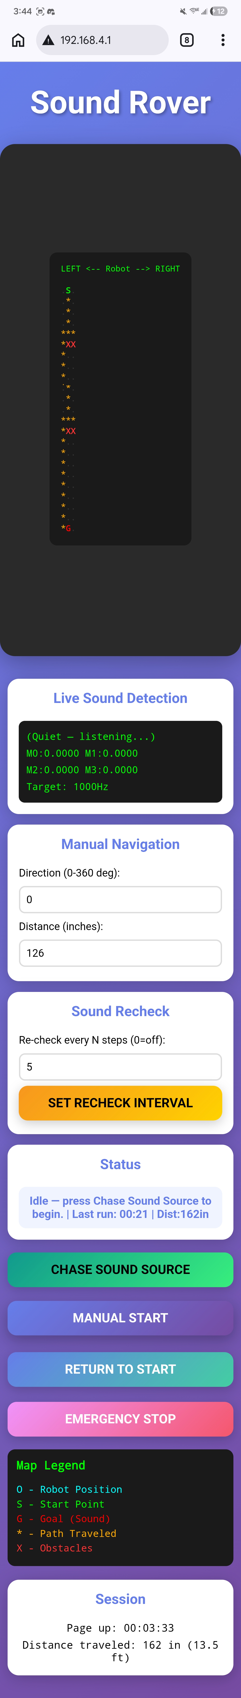
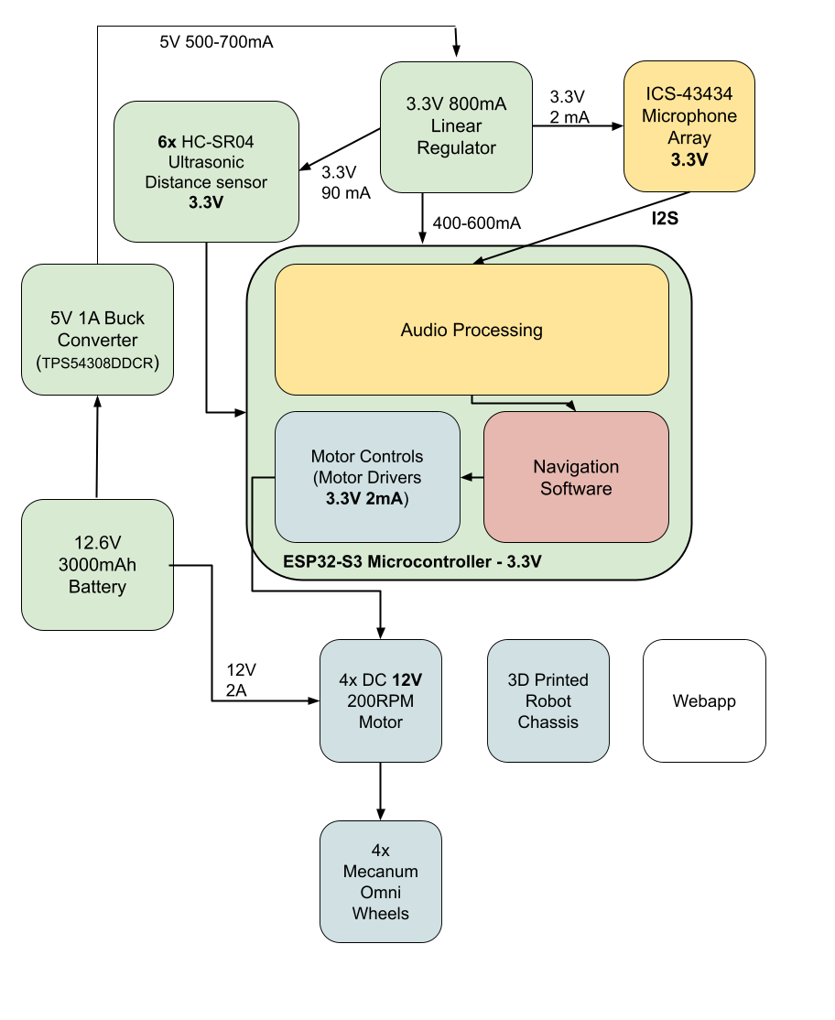
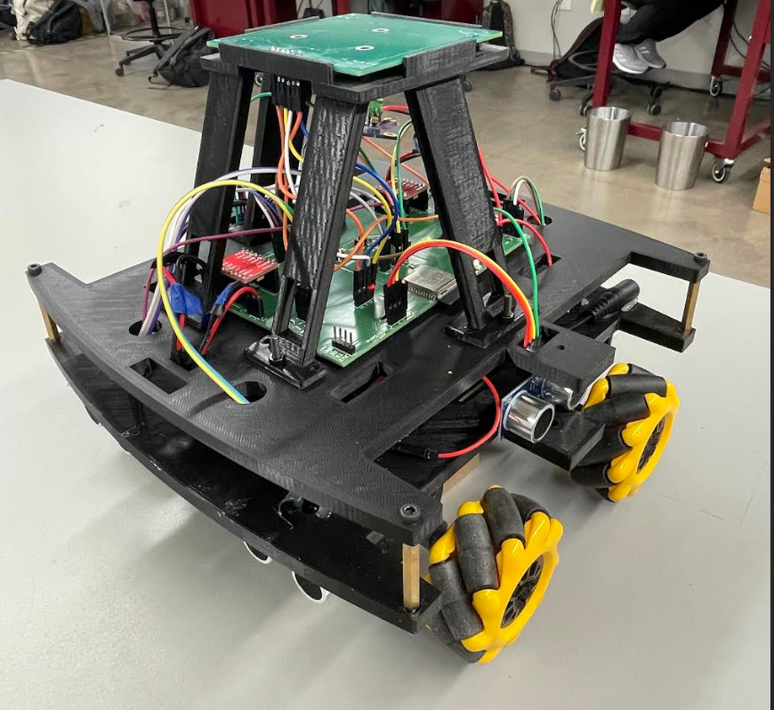
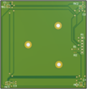
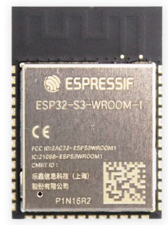
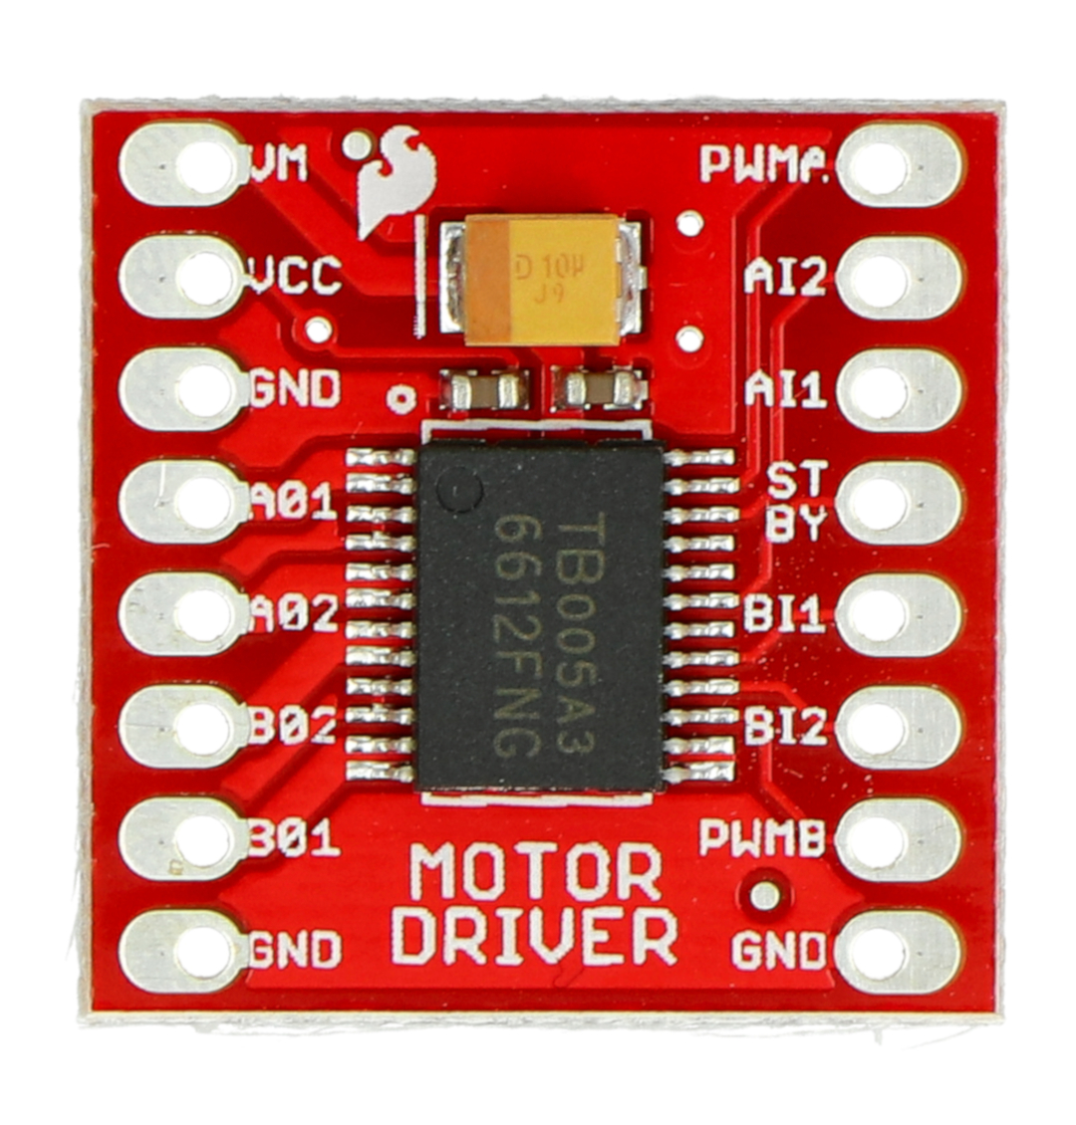
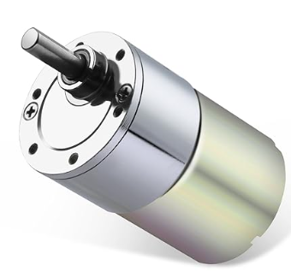
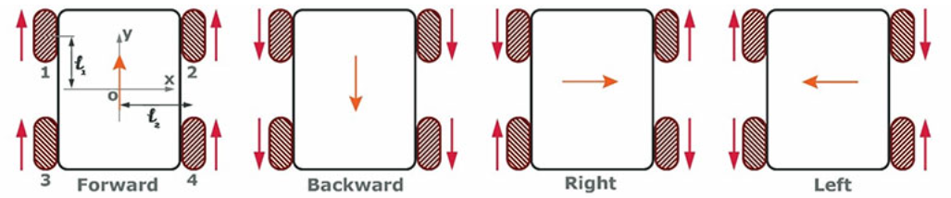
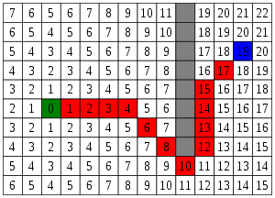
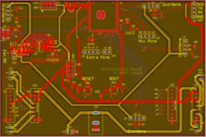
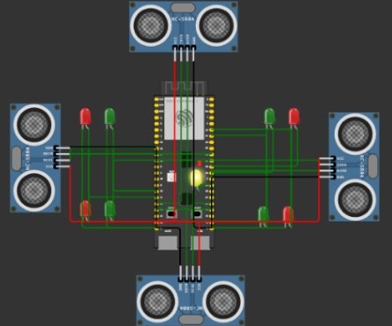
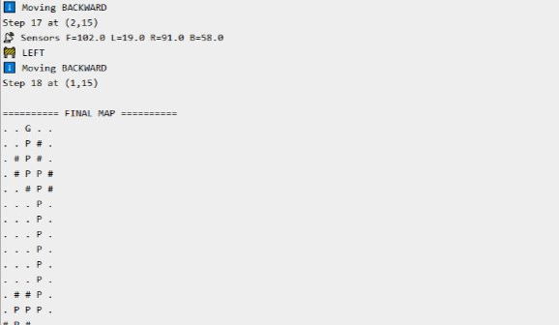
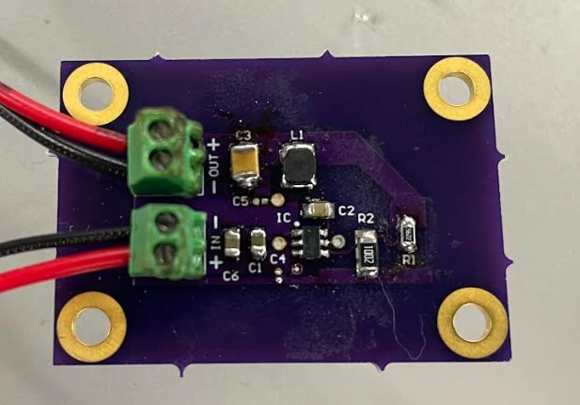
Sound Localization Robot 5​ Samuel Lackey, Joshuah Teele, Lucas Kettler, Sanjana Pasumarthi​ Faculty Sponsor: Dr. Moreira
Problem Definition
First Responders lack reliable methods for navigating dangerous environments, where visibility is limited, putting both their safety and the victims at risk
Acoustic Input Subsystem
Rover Design & WebApp Subsystem
Integrated Rover System
4x ICS-43434 MEMS Microphones in a 2.5in x 2.5in custom PCB​
Computes SRP-PHAT to beamform and phase transform a specific frequency even in poor acoustic conditions.​
Smooths angle across a 0.5 second interval
3D printed Chassis Design with Mecanum wheels
Brushless DC motors take input signals from motor drivers, directions are preset input bits to signal high and low (Forward, Backward, Diagonal, Rotation)
PWM set to 80-90% of power capacity
Synchronize motor by direction instead of speed
4
Methodology
1
5
TB6612FNG
6
7
2 Dual Motor Drivers: 8-bit signal
4 Brushless DC 12V Motors
8
ESP32 Module
2
***Slower speed at sideways movements
3
Figure 2. Microphone Array
Web app and server generated by internal ESP-32 Wi-Fi
TCP web socket which is accessible by any device that has Wi-Fi capabilities (multiple users & no password set)
Navigation Map
Sound Detection Analysis (Angle & Frequency)
Manual Navigation
Sound Recheck
Status Display (Time, Distance Traveled)
Start Button
Return to origin
Emergency Stop
Navigation Subsystem
Figure 1. Team Subsystem Diagram
Figure 6. Integrated Robot System
Input Software
SRP-PHAT time difference of arrival to determine angle
Tracks movement and sound magnitude to determine distance
Navigation Software
Incremental A* search algorithm
Instantaneously updating Grid map via sensors
Manhattan heuristic (No diagonal movement)
Power & Sensors
Distance sensors used to detect obstacles
Motors/ Chassis Design & Webapp
3D Printed Chassis Design with direction synchronized brushless DC motors to control Mecanum wheels
TCP Web socket ensures dual communication between rover and user
Microcontroller Board​
Design based on ESP32-S3. Contains sites on board for 2 motor drivers, 4 motors, 4 distance sensors, as well as 5 spare pins. Takes in 12.6V from the battery for the motors.
Power Subsystem
Results
***More Accurate results at shorter distances
ME: +/- 3.83 %
Figure 5. MCU Board with ESP32
ME: +/- 10.98 %
Figures 3&4. Navigation Diagram and Implementation
Adds “cost” of nodes to find shortest path
Modified to restart algorithm upon obstacle detection to find new shortest path
Expands map in large rooms
Figure 7. Full System Results
Acknowledgements A big thank you to Dr. Moreira, Dr.Lusher, and Dr.Nowka for their expertise and guidance.

